Slide 1
ML modelling to predict if a customer books a ticket with British Airways

Slide 2
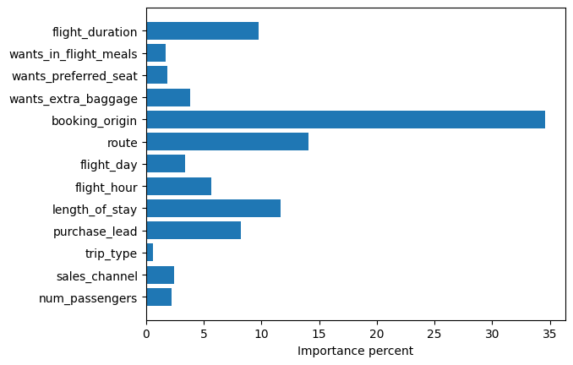
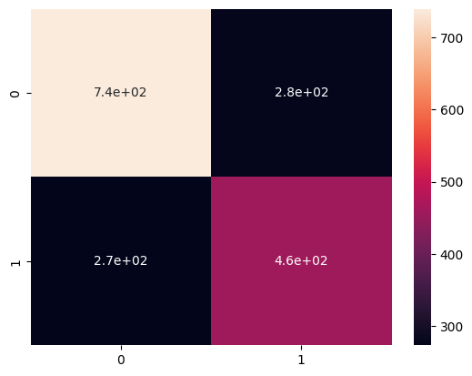
By using Random Forest classification algorithm, we can now predict if our web users choose to fly with us or not.
The algorithm has the following acuuracy scores in a 5-fold validation testing
5 fold - cross validation scores are [0.70451945 0.70051487 0.7028032 0.70729614 0.69413448]
Average cross validation score is 0.7018536287537279
Standard deviation 0.004449870882572593
The following 2 images summarizes the results of the model,
The importance of each features are visulized here in the following bar plot (in terms of %)
The confusion matrix from which we can determine the number of false negatives, false positives etc

